Slide 1


ma Better
ON
GLOBAL TERRORISM ANALYSIS
BY : MOHD ASJAD (cohort : chicago)

Slide 2
CONTENT
1) GLOBAL TERRORISM
a) Exploratory Data Analysis
b) Correlation Analysis
c) Terrorist Activities by Region in each Year
d) Number of Terrorist Activities each Year
e) Number of Casualties Vs Deaths in each Country
f ) Method of Attack
g) Type of Target
h) Total no. of Terrorist Attack in each Country and Regions
i) Total no. of Attacks
j) Most Active Terrorist Organizations
k) Trend of Terror before and after the War
CONCLUSION

Slide 3
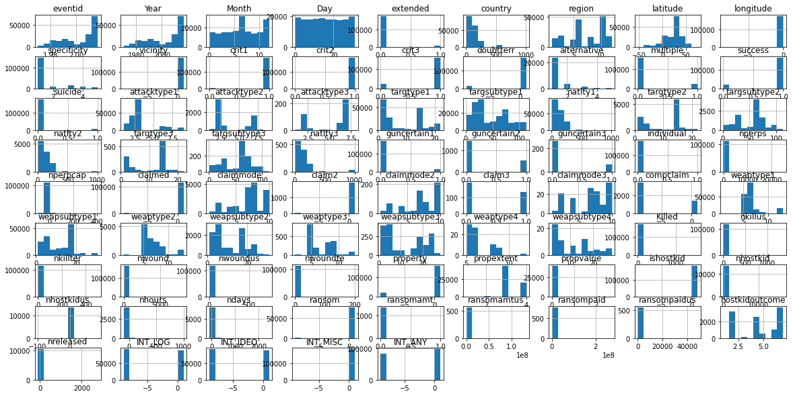
EXPLORATORY DATA ANALYSIS

Slide 4
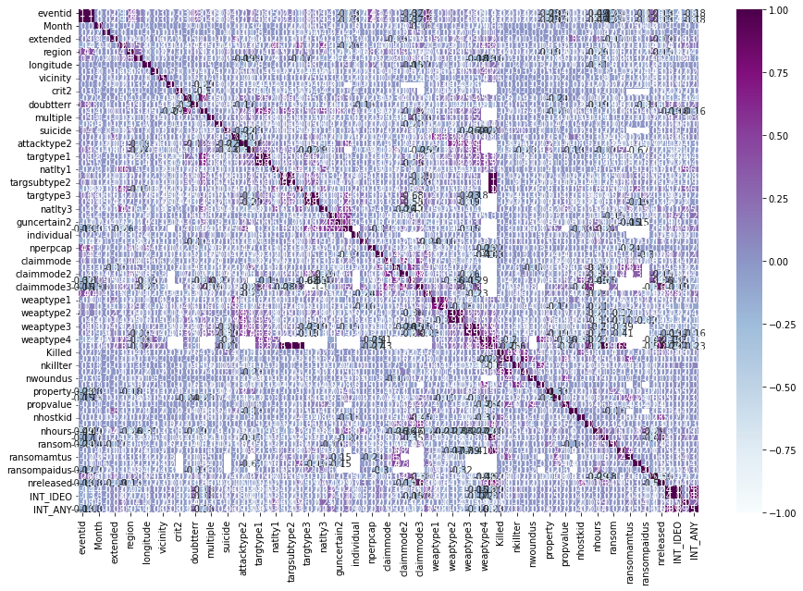
CORRELATION ANALYSIS

Slide 5
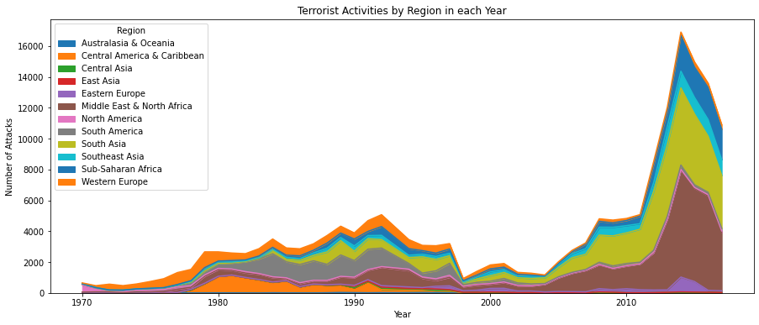
TERRORIST ACTIVITIES BY REGION IN EACH YEAR

Slide 6
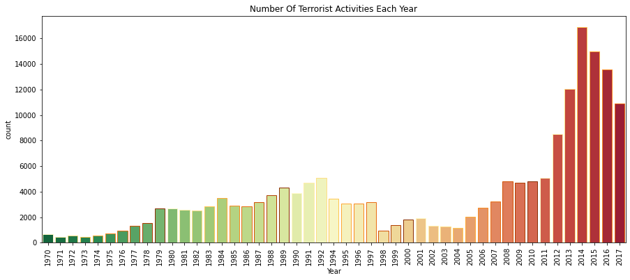
NUMBER OF TERRORIST ACTIVITIES EACH YEAR

Slide 7
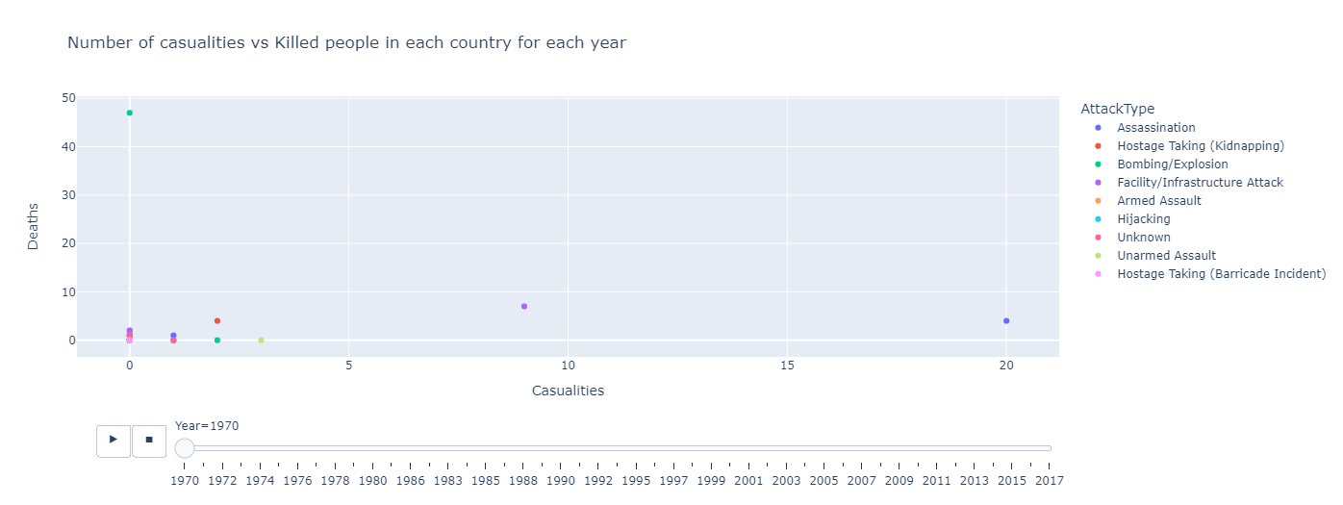
NUMBER OF CASUALTIES V/S DEATHS EACH COUNTRY

Slide 8
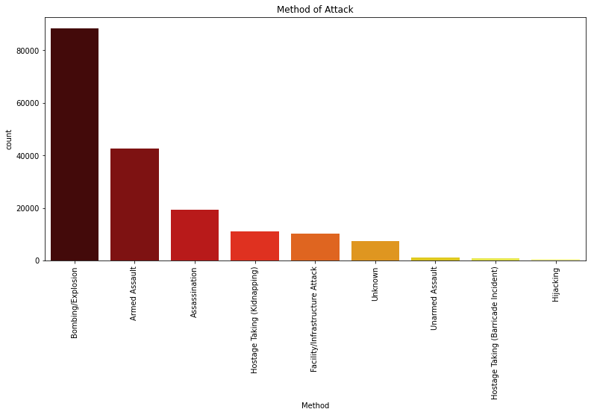
METHOD OF ATTACK

Slide 9
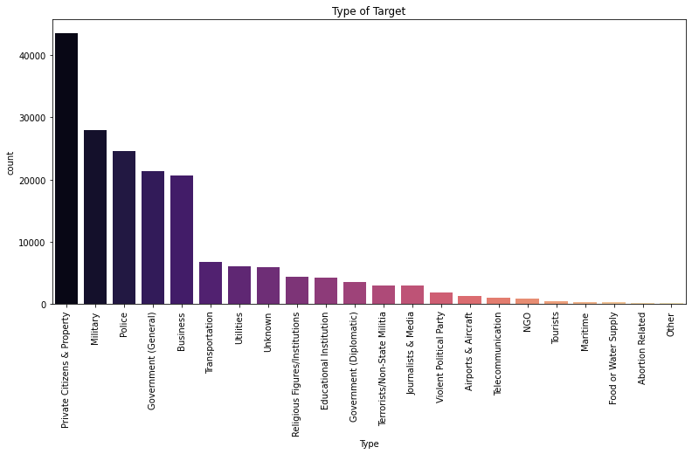
TYPE OF TARGET

Slide 10
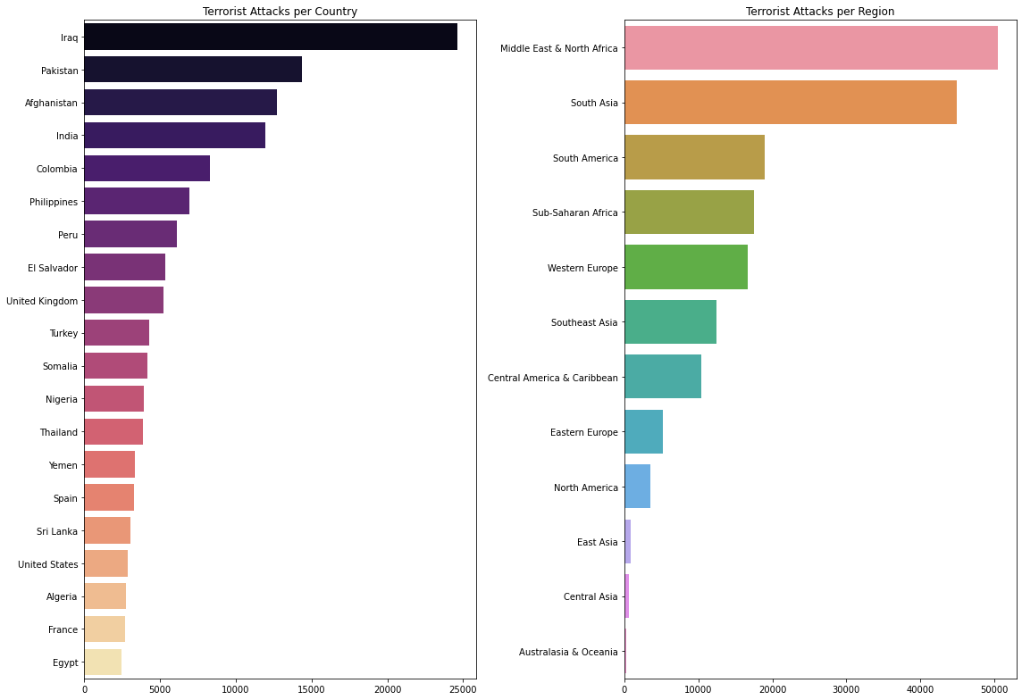
TOTAL NO OF TERRORIST ATTACK IN EACH COUNTRY AND REGIONS

Slide 11
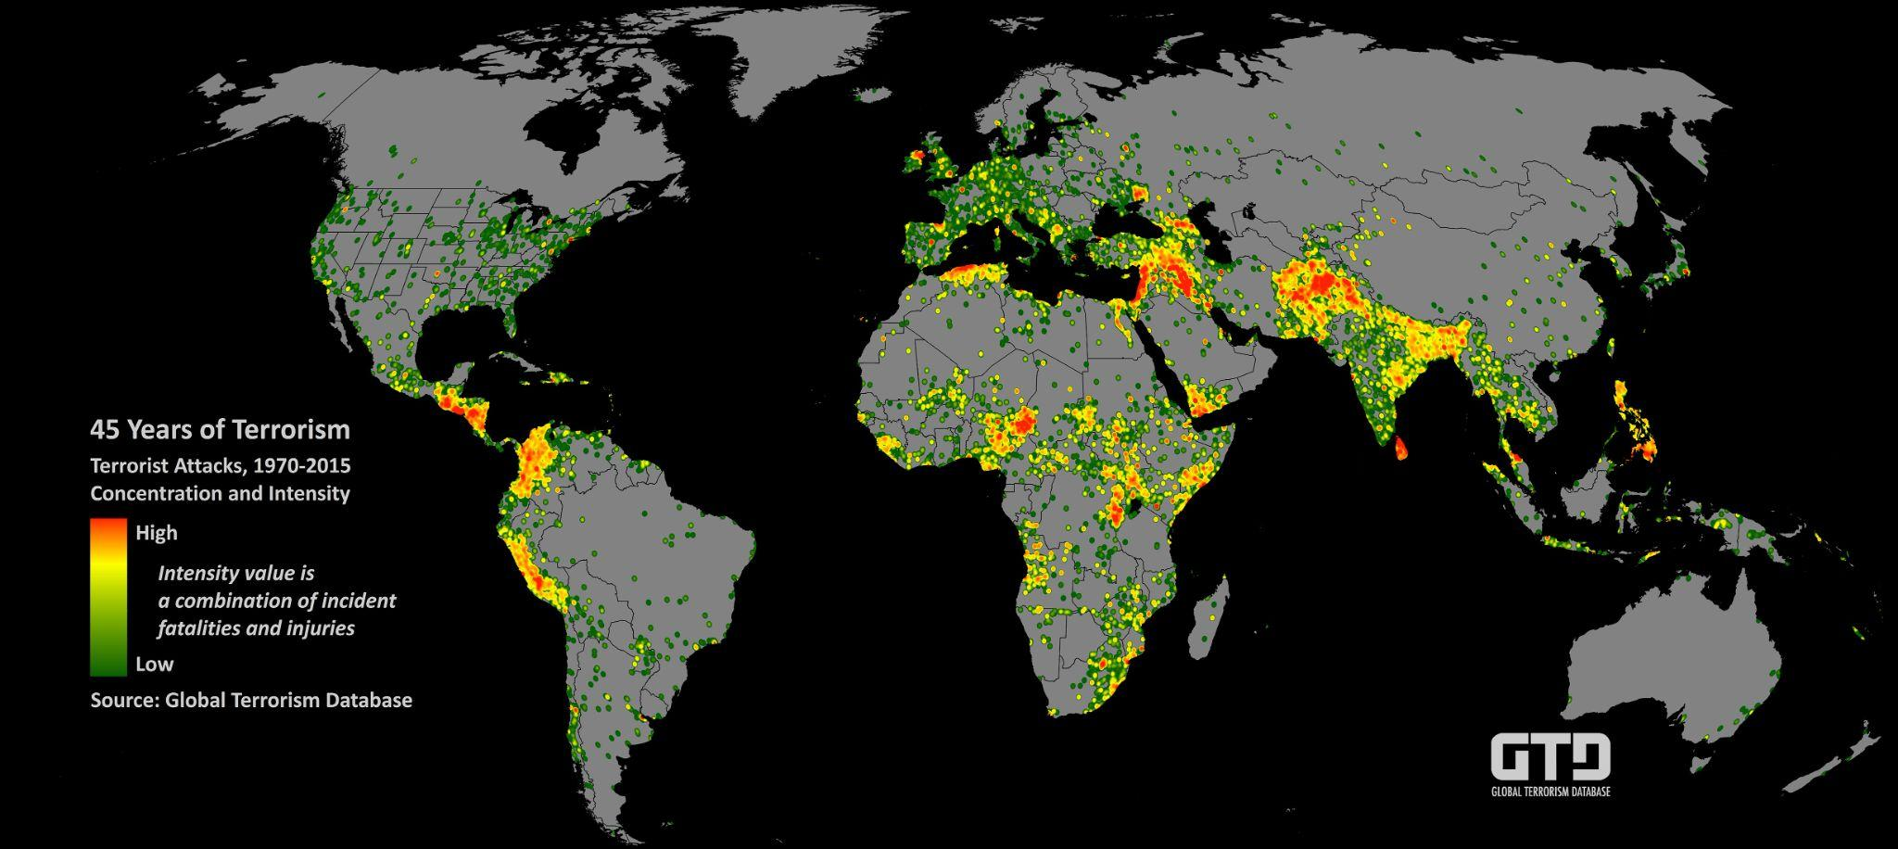
TOTAL NO OF ATTACKS

Slide 12
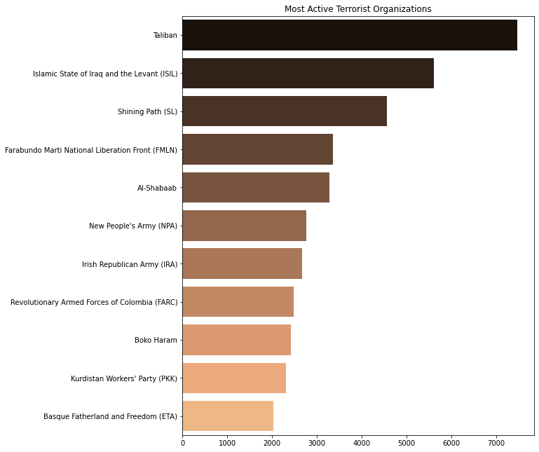
MOST ACTIVE TERRORIST ORGANIZATIONS

Slide 13
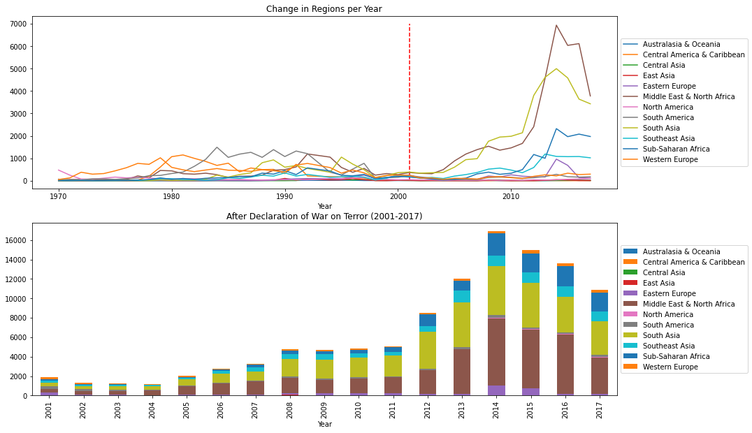
TREND OF TERROR BEFORE & AFTER THE WAR

Slide 14
CONCLUSION
1) Attacks has increased but rate of people killed are much higher than rate of attack happened.
2) Iraq has the most attacks.
3) The Middle East and North Africa Regions are most targeted Regions.
4) Maximum number of attacks are through Bombing/Explosions.
5) The maximum number of attacks are in civilians areas OR in their Properties.
6) Taliban and ISIL are most active organisations.

